Slide 1
Tourism Performance
Refilwe Molatlhegi
Acting Head: Analytics
South African Tourism

Slide 2
Analytics & Insights
Purpose and Vision
The Analytics and Insights Division plays an essential role in supporting South African Tourism to achieve its impact and outcomes, as it works to provide centralised tourism intelligence and establish South African Tourism as a thought leader in the sector.
In contributing to the South African Tourism strategic focus, impact and outcomes, the Analytics and Insights Division defines its aim/purpose as:
To provide centralised tourism intelligence and establish South African Tourism as a thought leader in the sector.
Being THOUGHT LEADERS in the industry means we:
Trailblaze by setting the industry standard in tourism intelligence.
How:
By being seen as a credible partner that swiftly provides ground-breaking and customer-centric solutions

Slide 3
Impact of tourism on GDP and Jobs
Global tourism performance

Slide 4

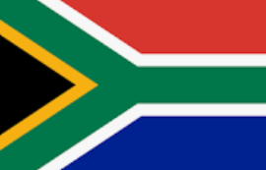
WTTC – Impact of Tourism Global and Tourism in SA. All matrices took a dip in 2020 and improved in 2021 (but not yet at 2019 levels)
Total GDP contribution
Year | % GDP Contribution | USD Value GDP (BN) | YOY Change
2019 | 10,3% | $9,630 | +4,7%
2020 | 5.3% | $4,775 | -50,4%
2021 | 6.1% | $5,812 | +21,7%
Year | % Total Contribution | ZAR BN
2019 | 6,4% | R405,2
2020 | 3,1% | R180.0
2021 | 3,2% | R195.2
Total Travel and Tourism Jobs
Year | Jobs (Million) | Ratio of Jobs | YOY Change
2019 | 333 | 1 in 10 jobs | +8.7 mn
2020 | 271 | 1 in 12 jobs | -62 mn
2021 | 289 | 1 in 11 jobs | +18.2 mn
Year | Jobs MN | % of total jobs
2019 | 1.51 | 9.3%
2020 | 1.06 | 7%
2021 | 1.08 | 7.3%
The World Travel & Tourism Council is a forum for the travel and tourism industry. It is made up of members from the global business community and works with governments to raise awareness about the travel and tourism industry

Slide 5
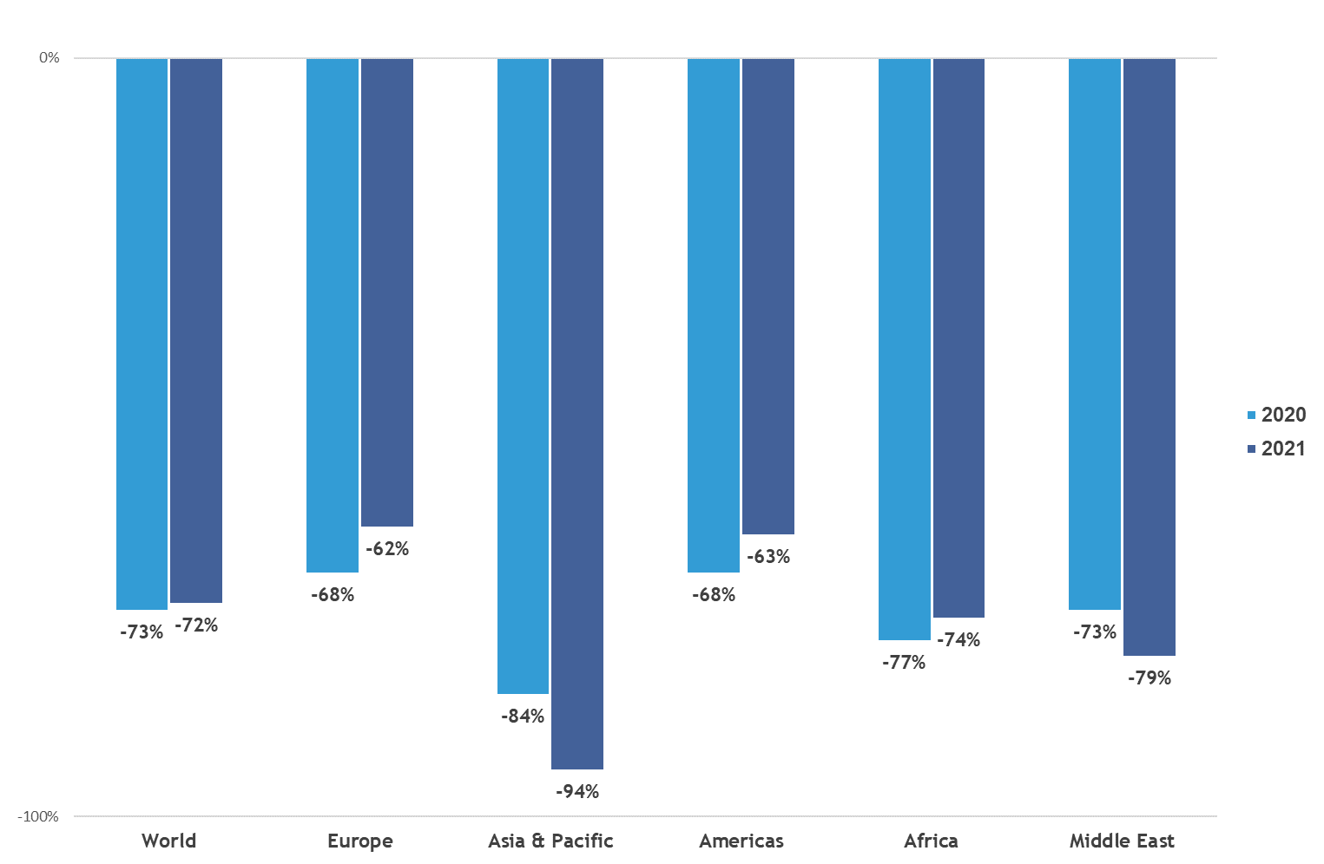
Global Performance in 2021
Global tourism experienced a mild 4% upturn in 2021 vs. 2020 but was still 72% below pre-pandemic levels. The small recovery in 2021 was mainly in the 3rd and 4th quarters of 2021
Rising vaccination rates combined with softer travel restrictions due to increased cross-border coordination and protocols, have all helped release pent up demand in 2021. Europe and the Americas recorded the strongest results.
Africa remained 74% below 2019 levels.
International Tourist Arrivals % Change vs. 2019²
UNWTO World Tourism Barometer Volume 20, Issue 1, January 2022. Change for 2019 is vs. 2018.
³ UNWTO Recovery Tracker, https://www.unwto.org/unwto-tourism-recovery-tracker. Actual data for 2021 is preliminary and based on estimates for some destinations.

Slide 6

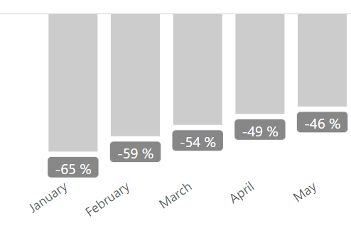
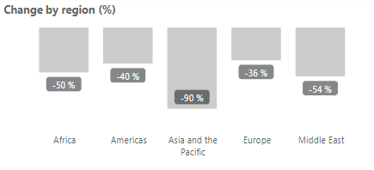
Global Performance January - May 2022
International tourism continues to show signs of a strong and steady recovery.
Globally arrivals were 54% below 2019 levels.
There has been a steady improvement globally from January to May 2022.
Europe was the best performing region with 36% below 2019 levels
Americas performed at 40% below 2019 levels which makes it the second-best performing region
Asia and Pacific is still the worst performing region due to border closers and strict travel policies.
The African region performed well at 50% below 2019 levels
Source: UNWTO
Jan-May, SA is -57% below 2019 levels and has improved in June to -55%

Slide 7
International Tourist Arrivals to South Africa

Slide 8
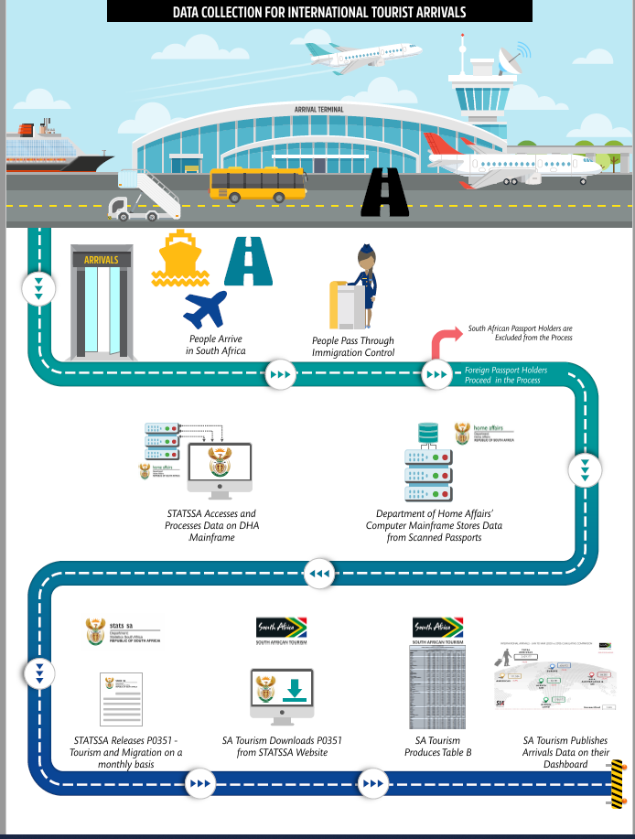

Slide 9
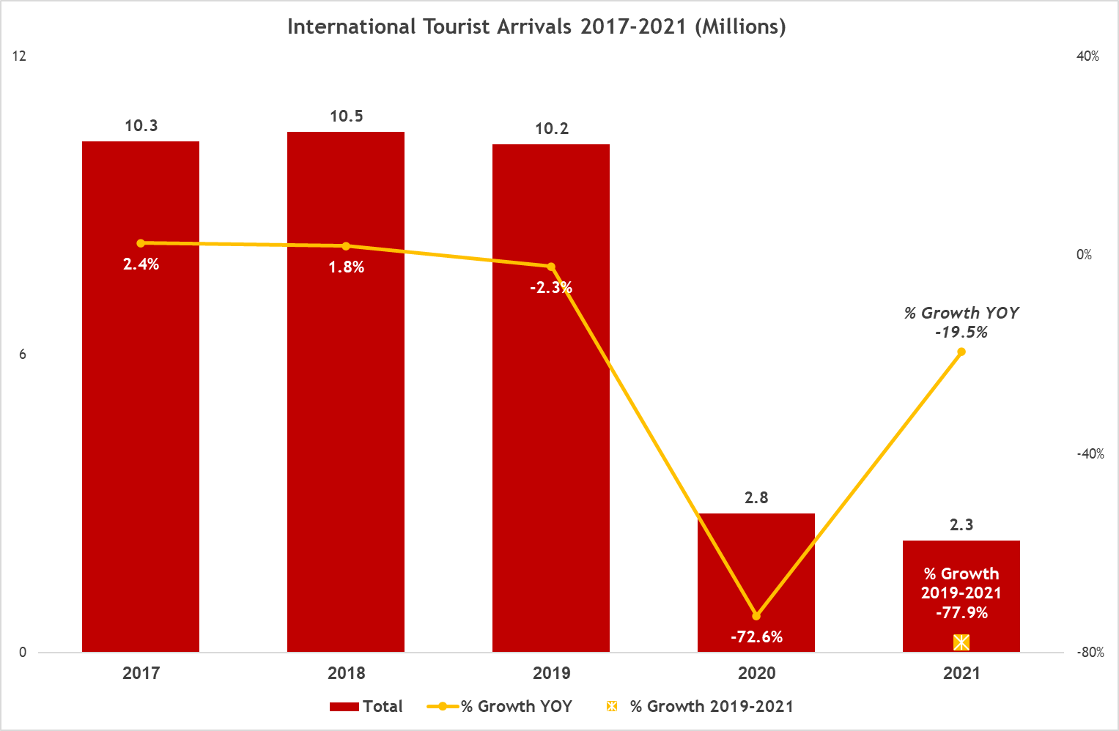
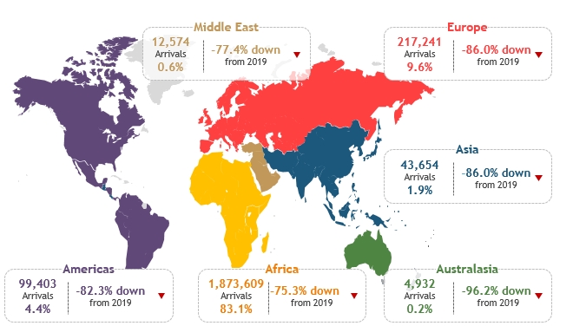
International Tourist Arrivals 2021
International tourist arrivals to South Africa reached 2.3 million in 2021 –0.5 million less than the 2.8 million recorded in 2020. This makes sense being given a strong Q1 2020. This result represents a -77.9% decline vs. 2019 or -19.5% vs. 2020 and is reflective of Covid-19’s continued impact although travel restrictions had been lifted on 1st October 2020.
The geographic distribution of tourist arrivals in 2021 continued to show the dominance of African tourists and it’s clear that the Covid-19 crisis further strengthened Africa’s foothold as it constituted 83.1% of arrivals, up by 8.8% from 2019. The next major source region remains Europe, but its share has been almost halved to reach 9.6%. All other regional shares have also been negatively affected with the Americas coming down to 4.4%, Asia 1.9%, and Australasia 0.2%.
International Tourist Arrivals 2021
(Actual, Share & Growth)
Statistics South Africa, Tourism & Migration Report 2021

Slide 10
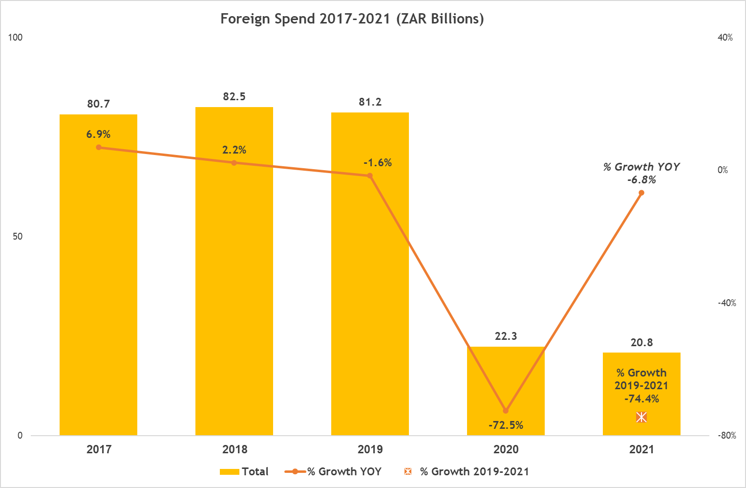
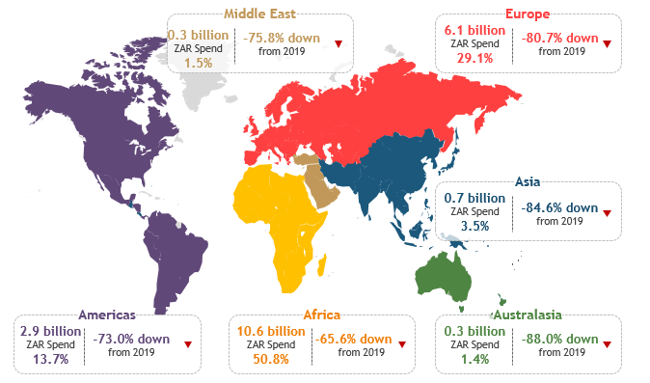
Total Direct Foreign Spend 2021
Tourists from Africa and Europe accounted for the bulk of foreign expenditure. This was expected given that the two were the largest sources of arrivals (92.7%). However, their shares of spend are inversely related to their share of arrivals, with Africa accounting for much less spend than arrivals (50.8% vs. 83.1%) and Europe inversely so with 9.6% share of arrivals but 29.1% of spend. Most regions’ expenditure had decreased.
Total Foreign Direct Spend by Region 2021
(Actual Billions, Share & Growth)
South African Tourism, Departure Survey 2021

Slide 11
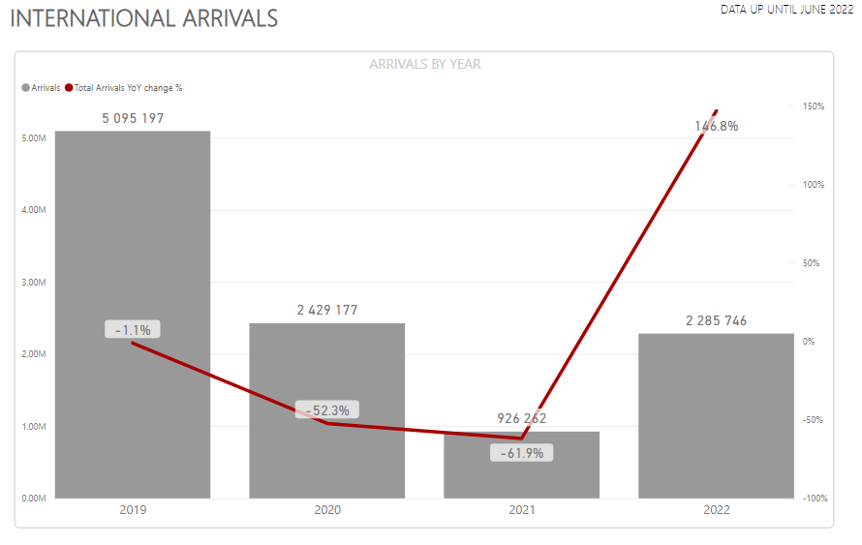
International Tourist Arrivals
January – June 2022
Total arrivals for the period of January – June 2022 was 2,3 million.
This was a 147% increase from January – June of the previous year.
January – June 2022 represented 45% of 2019 levels and therefore 55% below 2019 levels.

Slide 12
Departure Survey
Since 2002, South African Tourism has commissioned a monthly survey of departing foreign visitors, 18 years and older, exiting through OR Tambo International Airport, Cape Town International Airport, and the following 12 land border posts with the cooperation of SARS, Home Affairs, and ACSA;
Kopfontein (Botswana)
Pioneer Gate (Botswana)
Groblers Bridge (Botswana)
Ramatlabama (Botswana)
Lebombo (Mozambique)
Ficksburg (Lesotho)
Maseru (Lesotho)
Oshoek (Swaziland)
Golela (Swaziland)
Beit Bridge (Zimbabwe)
Nakop (Namibia)
Vioolsdrif (Namibia)

Slide 13
Departure Survey
Objectives of the survey are:
As this is the only national survey that measures tourist behaviour in South Africa, it is used by other stakeholders in government (national and provincial) and the private sector. These surveys are the only measure of tourism demand in South Africa and cover, in particular, the following broad areas:
Reasons for visiting South Africa
How long the visitors spent in South Africa
Information pertaining to the sites visited their satisfaction levels with the facilities and services and types of accommodation used. This has been broken out into each of the provinces of South Africa.
Their expenditure patterns while in South Africa
How the decision was made to visit South Africa
What their travel arrangements were
Their overall impressions of their visit to South Africa
Their travels to other African countries
Personal demographic information
Questionnaire is not limited to the Above.

Slide 14

Arrivals by Region: January – June 2022
All international tourist arrivals by regions have increased in January - June 2022 over the same period of 2021. The geographic distribution of tourist arrivals in 2022 continued to show the dominance of African tourists with 1,7 million arrivals
Arrivals by Regions | 2021 | 2022 | % Δ
Africa | 817 377 | 1 714 501 | 109.8%
Europe | 53 715 | 356 352 | 563.4%
Americas | 29 901 | 128 911 | 331.4 %
Asia | 18 146 | 47 912 | 164.0%
Australasia | 1 558 | 21 108 | 1254.8%
Middle East | 3 885 | 12 795 | 229.3%
Statistics South Africa, Tourism and Migration June 2022

Slide 15
Spend by Region: January – June 2022
Total foreign direct spend have recovered tremendously reaching 21.5 billion, for the 1st half of the year reaching an increase of 168.7% over 2021
Total Foreign Direct Spend (TFDS) | 2021 | 2022 | %Δ
Africa | R 4 702 447 161 | R 8 116 045 343 | 72.6%
Europe | R 2 023 423 565 | R 8 159 278 612 | 303.2%
Americas | R 674 526 226 | R 3 770 118 659 | 153.6%
Asia | R 350 592 649 | R 691 766 042 | 97.3%
Australasia | R 194 593 922 | R 493 578 948 | 153.6%
Middle East | R 70 981 993 | R 306 602 649 | 331.9%
Total Spend | R 8 016 565 516 | R 21 537 390 254 | 168.7%
South Africa Tourism, Departure survey Jan-June 2022

Slide 16
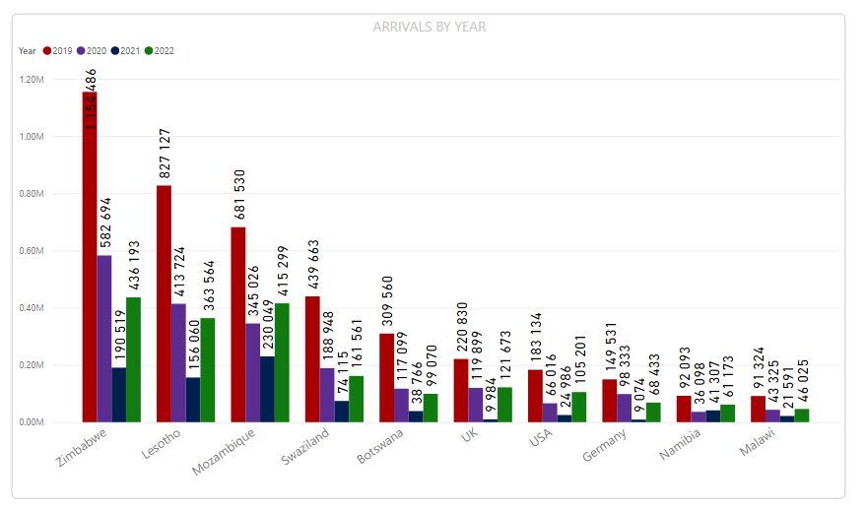
International Tourist Arrivals
January- June 2022 cumulative arrivals by Country – Top 10 markets
In 2022 Zimbabwe accounted for most arrivals to South Africa.
Mozambique followed closely in second place followed by Lesotho in 3rd place.
The largest overseas market was the UK followed by the USA and then Germany.
Statistics South Africa, Tourism and Migration June 2022

Slide 17
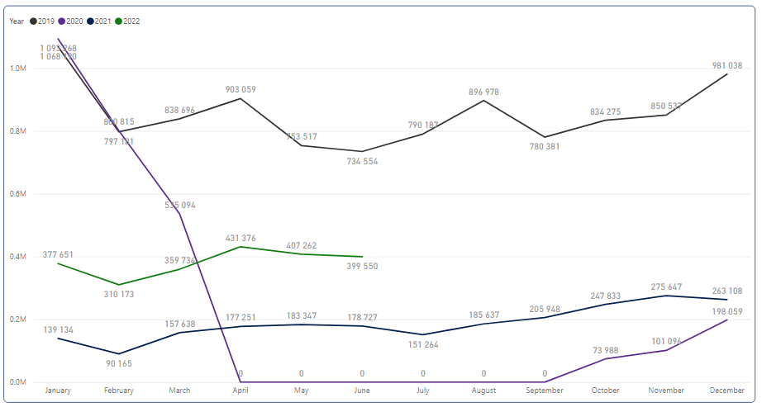
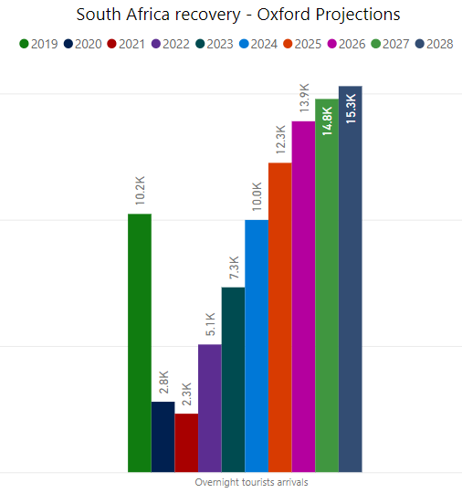
International Tourist Arrivals
Seasonality
The best performing month in 2022 was April driven by an increase in arrivals from Zimbabwe and Lesotho.
2022 is performing better than 2021 on a monthly basis but has still not reached 2019 levels.
It is expected that South Africa will reach 2019 levels in 2025.
Statistics South Africa, Tourism and Migration June 2022

Slide 18
International Tourism Performance in Eastern Cape

Slide 19
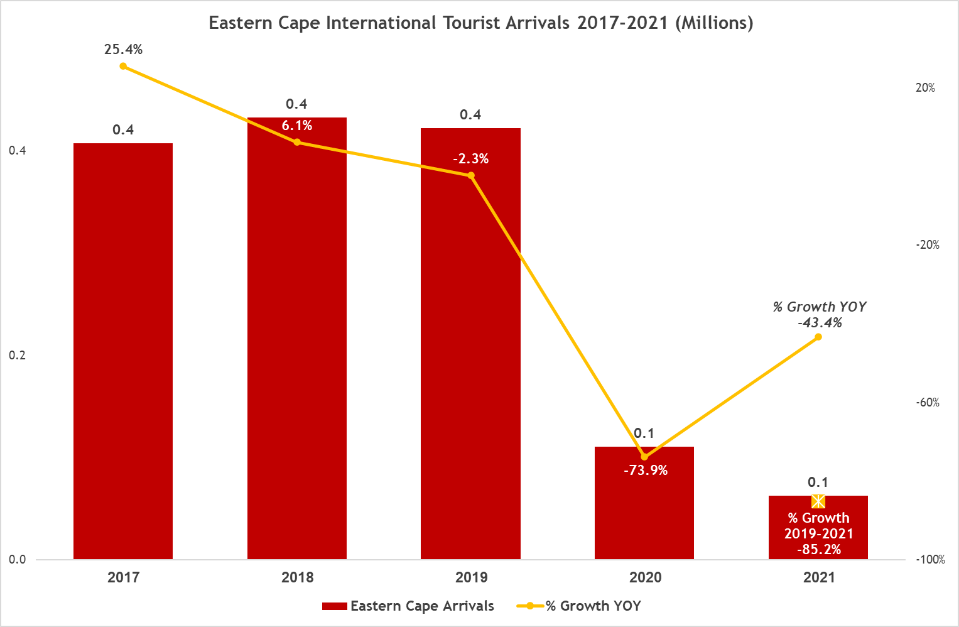
The total number of international tourists that visited Eastern Cape in 2021 decreased by 85.5% to a total of 0.1 million when compared to 2019 and by 43.5% over 2020.
Statistics South Africa, Tourism and Migration June 2022

Slide 20
Arrivals to Eastern Cape by top 10 markets

Slide 21
Top 10 attractions in Eastern Cape

Slide 22
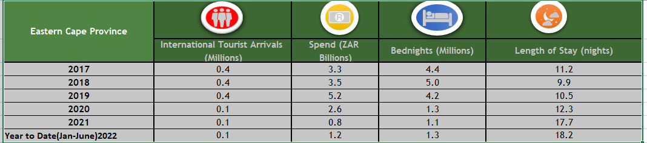
Key international performance indicators, Eastern Cape
The latest data shows an improvement in tourism consumption in the Eastern Cape. This narrative correlates with the national data.
Statistics South Africa, Tourism and Migration June 2022 , SAT Departure Survey 2022

Slide 23
Domestic Tourism Performance

Slide 24
Domestic Tourism Survey
Since 2007, South African Tourism commissioned a monthly household survey of the South African population 18 years and older to measure headline indicators of domestic tourism. The following key indicators are measured:
Volume: the incidence of domestic travel and how many trips are taken
Value: how much is spent by domestic tourists
Number of bed nights: The number of nights spent in various establishments
Provincial distribution: How the volume, value and bed nights are distributed between the nine provinces
Seasonality: When do people travel?

Slide 25
Domestic Tourism Survey
Objectives of the survey are:
Determine the incidence of travel among the adult population;
Quantify trips taken by travellers over a 12-month period;
Understand the timing of trips to specific provinces;
Measure the average length of stay per trip;
Understand the usage of provincial facilities, such as accommodation, transport and tourist attractions;
Measure satisfaction with various provincial facilities and overall friendliness and efficiency of the provincial Tourism product;
Determine an approximate value of the trips, taking all trip related expenditure into account;
Identify the reasons for travelling and not travelling; and
Identify the incidence of province choice and reasons for choosing that particular province.

Slide 26
DOMESTIC KEY MEASURES – Annual Performance
Total domestic trips amounted to 14.8 million in 2021, -47.9% less than 2019 and -12.9% over 2020. This drop is due to the 2nd, 3rd and 4th waves that rippled the country throughout 2021 as well as the discovery of the omicron variant in December 2021. Which then negatively impacted the performance of domestic tourism for 2021.
Key measure |  | 2019 | 2020 | 2021 | Δ% 2020 vs 2021
 | Number of trips (Mn) | 28.5 | 17.0 | 14.8 | -12.9%
 | Average number of trips | 2.1 | 1.1 | 1.0 | -5.4%
 | Number pf domestic travellers (Mn) | 13.5 | 15.6 | 14.3 | -8.0%
 | Domestic spend (Bn) | R43.9 | R53.1 | R45.4 | -14.5%
 | Average domestic spend | R1,542 | R3,118 | R3,062 | -1.8%
 | Bednights (Mn) | 94.1 | 56.8 | 51.2 | -9.9%
 | Length of stay | 3.3 | 3.3 | 3.4 | 3.5%
 | Day trips | 236.5 | 108.0 | 68.8 | -36.5%
Source: SAT Domestic Survey

Slide 27
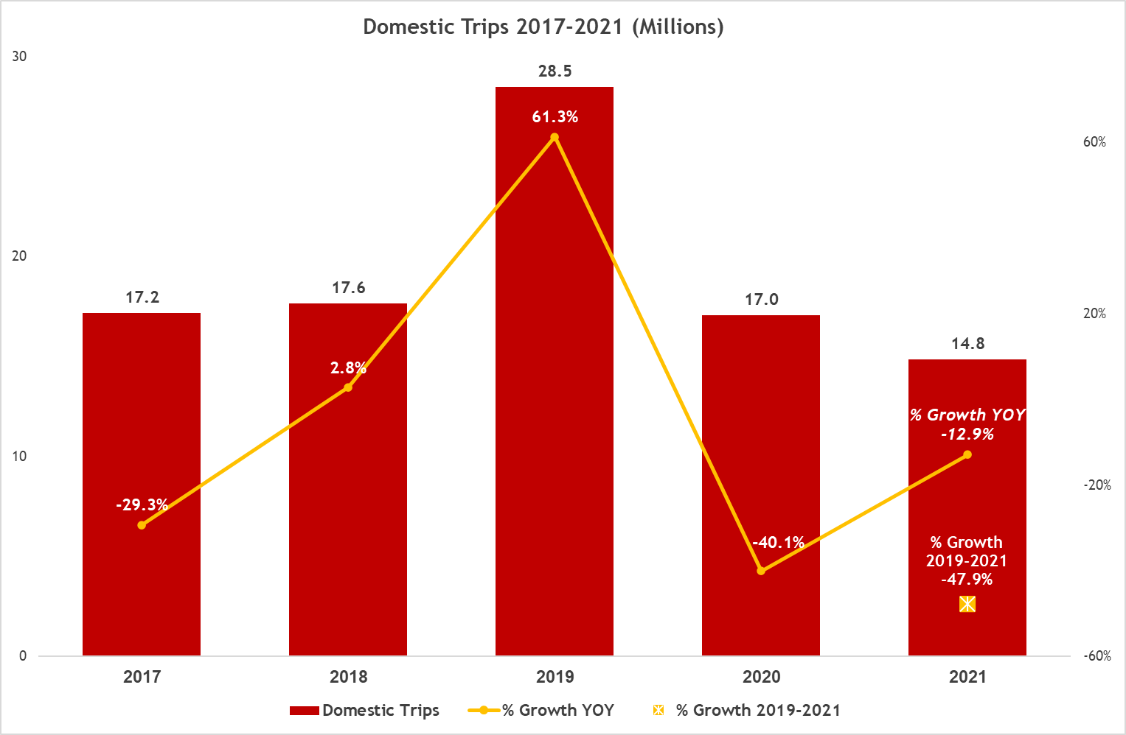
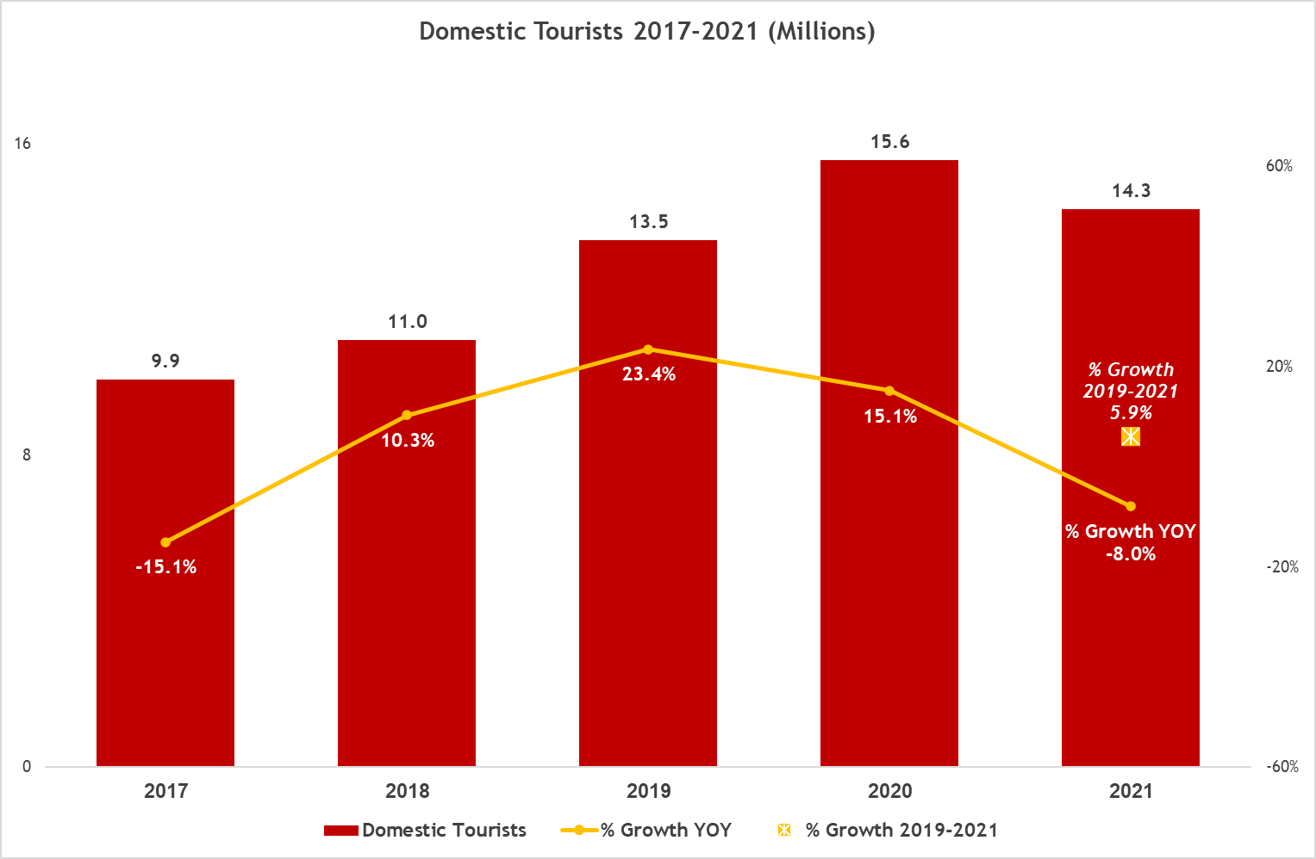
Domestic Tourism Performance
South African Tourism, Domestic Tourism Survey 2021

Slide 28
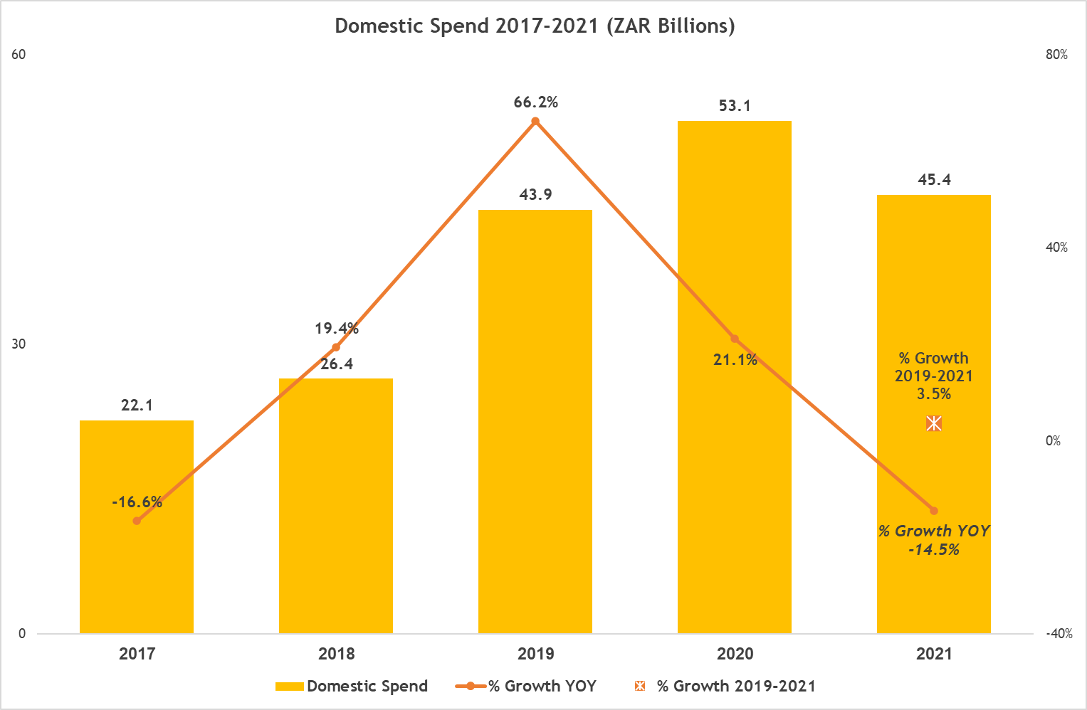
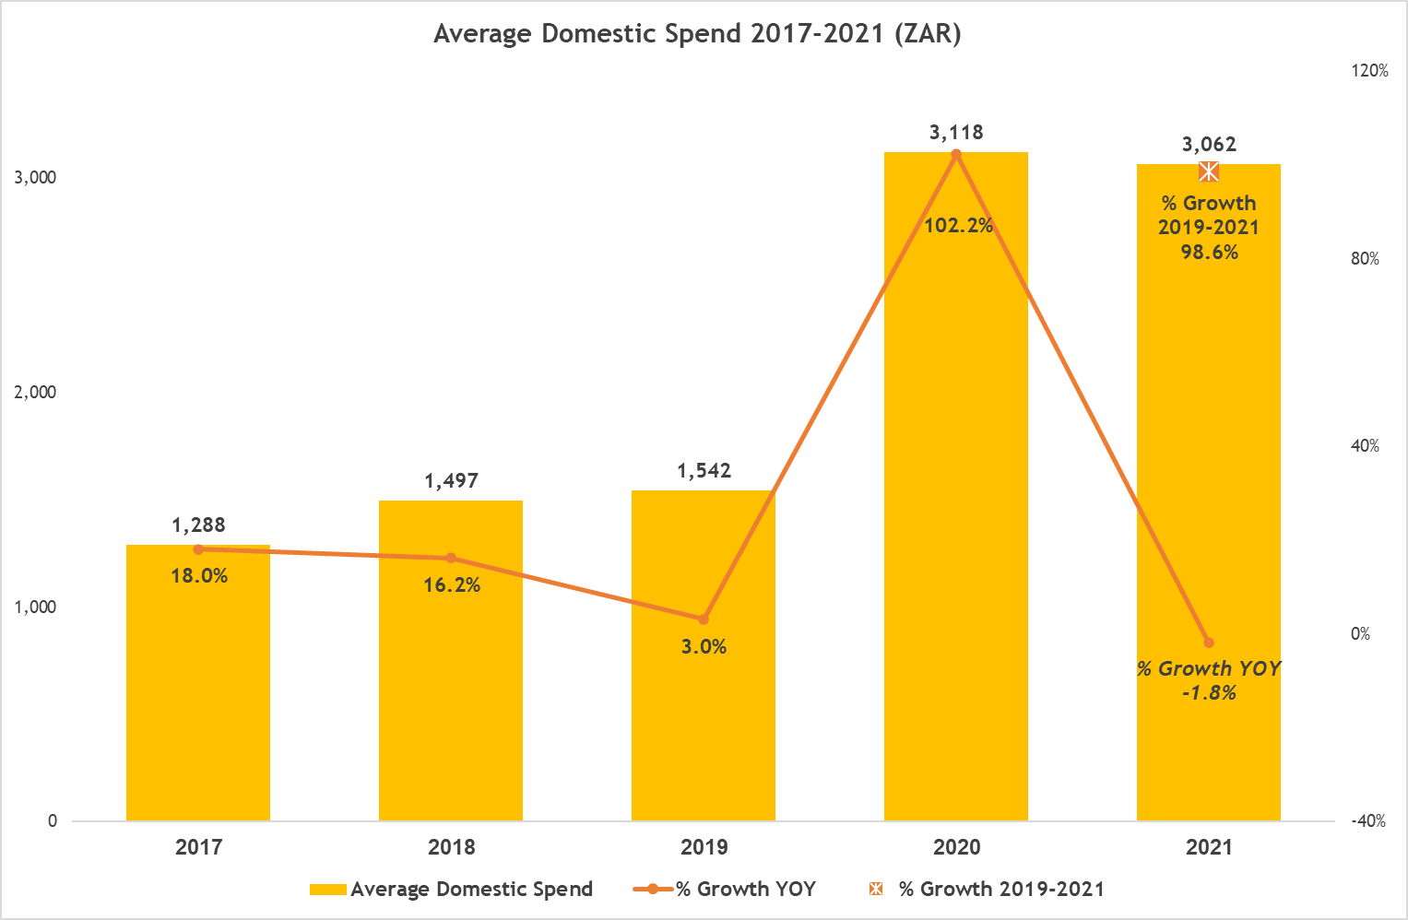
Domestic Tourism Performance
  Domestic revenue for 2021 was ZAR 45.4 billion, showing slight recovery (+3.5%) over 2019 and decreasing by 14.5% over 2020.
  Average spend shows a marked increase versus 2019 (+98.6%), but a very small loss compared to 2020 (-1.8%).
South African Tourism, Domestic Tourism Survey 2021

Slide 29
Domestic Key Measures: January – June 2022
Domestic trips have recovered tremendously reaching 15.2 million trips, 114.0% over 2021. Domestic spend has seen phenomenal growth thus far, rising by 175.2% over the first half of 2021. In line with the growth in spend, comes an increase in average spend which now equals ZAR 2,850.
Key measure |  | 2021 | 2022 | Δ%
 | Number of trips (Mn) | 7.1 | 15.2 | 114.0%
 | Domestic spend (Bn) | R15.8 | R43.3 | 175.2%
 | Average domestic spend | R2,217 | R2,850 | 28.6%
 | Bednights (Mn) | 24.6 | 52.8 | 115.1%
 | Length of stay | 3.5 | 3.5 | 0.5%
 | Outbound trips (Mn) | 0,6 | 1,6 | 146.4%
South African Tourism Domestic Tourism Survey 2022

Slide 30
Eastern Cape performance in the past 10 years

Slide 31
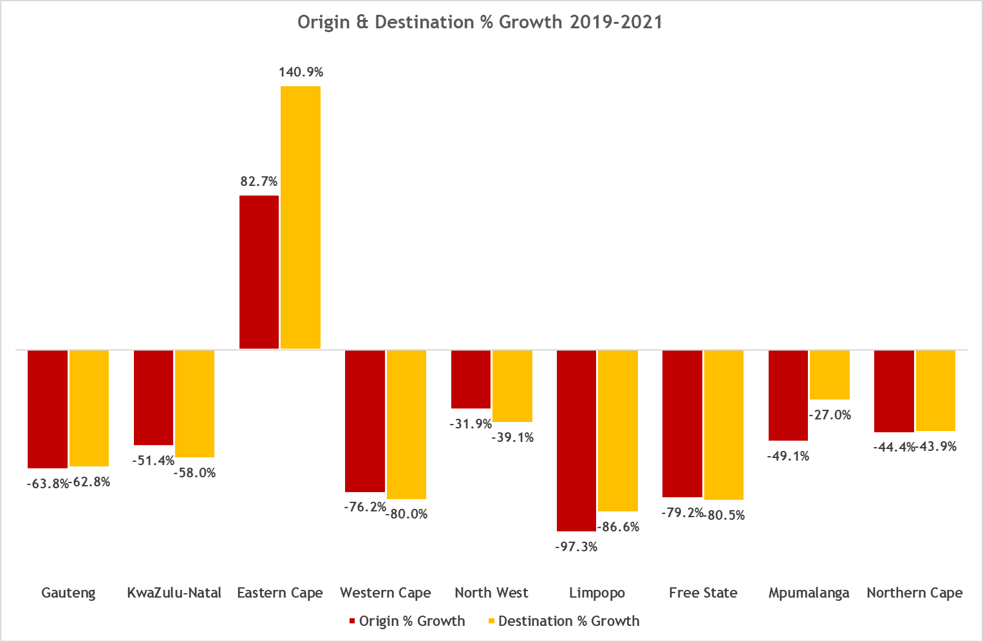
Provincial Performance 2021
  Putting origin and destination growth rates together outlines out the similarity in patterns.
  The Eastern Cape has shown phenomenal growth both as a source and a destination (+82.7 & 140.9%) whilst the North West and Mpumalanga’s decline rates are smaller, thus strengthening their shares.
  The decline in trips as well as the declines in cross-province travel has resulted in an overall geographic spread of 1.6%.
South African Tourism Domestic Tourism Survey 2021

Slide 32
Provincial Performance 2021
Share of Domestic Destination by Origin 2021
(Destination across, Origin going down)
  Crossing origin as well as destination shares highlights further the importance of intra-provincial domestic travel during the Covid-19 crisis. It’s clear that same-province travel is at its highest in the coastal provinces of the Eastern Cape (94.6%) and the Western Cape (72.9%).
  In the case of Gauteng, it’s clear that cross-province travel is driven by proximity and the ability to arrive by car and not by plane. Hence, Limpopo stands for 63.3% of all travel from Gauteng, the North West 31.5% and Mpumalanga 29.5%.
South African Tourism Domestic Tourism Survey 2021

Slide 33
Provincial Performance 2020
Share of Domestic Destination by Origin 2020
(Destination across, Origin going down)
South African Tourism Domestic Tourism Survey 2021

Slide 34
Domestic Trips by province of origin, January – June 2022
Majority of the trips originated from KwaZulu Natal, followed by Limpopo and the Eastern Cape.
SA Tourism, Domestic Tourism Survey 2022

Slide 35
Domestic Trips by province of destination, January – June 2022
In terms of provincial trip destination, the provinces of KwaZulu-Natal, Eastern Cape and Gauteng received the most trips The bulk of provincial travel in all provinces was attributed to intra-provincial travel.
SA Tourism, Domestic Tourism Survey 2022

Slide 36
Domestic Spend by Province, January – June 2022
A total spend of R43,3 billion was recorded so far in 2022.
KZN contributed the most by R13.4 billion, followed by Gauteng with R8.1 billion and Limpopo with R5,9 billion.
The Eastern Cape contributed R4.3 billion, ranking above Free State, Mpumalanga, North West and Northern Cape.
SA Tourism, Domestic Tourism Survey 2022

Slide 37
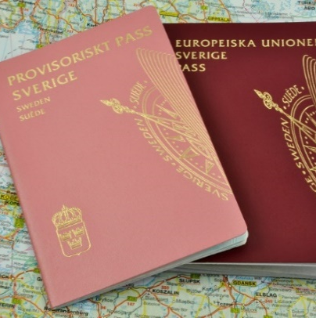

Insights: Why domestic travel increased in 2022?
The biggest driver of domestic travel in the first six months of 2022 was the ease on travel restrictions. In the first quarter of 2021 South Africa was on Adjusted alert level 3, with the closure of beaches and the ban of alcohol sales. Which are some of the two top drivers of domestic travel. The ease and removal of travel bans has created a pent-up demand for travel for beaches, connecting with family and friends and socializing.
WHEN AND WHERE DO THEY TRAVEL?
Average spend per trip has increased, which means that South Africans saved their travel money during lockdown travel restrictions so that they can take the one trip have they been looking forward to for two years.
In Jan – June 2022, there were more domestic trips undertaken (15,2 million trips). This was higher than pre-pandemic levels. Indicating that South Africa’s domestic tourism also experienced the revenge travel trend.
The biggest spend by category was on transport and accommodation. For the first time spending on the leisure category was the same as the spending on the food category. This indicates that domestic tourists were involved in tourism activities during their trip.
Visiting friends and relatives (VFR) continued to be the top purpose, however the share of trips for VFR has decreased. While the share of holiday trips has increased from 16,8% in the first half of 2021 to 23,8% in the same period of 2022.
Source: South Africa Tourism Domestic Survey

Slide 38
Insights: Why domestic travel increased in 2022?
The first quarter of the year, the summer months, and school holidays are generally travel months for South Africans. During these periods in 2021, especially in January and February, the country was on adjusted alert level 3 which included the closing of beaches, banning of alcohol and restrictions on social gatherings, which are the key activities for South Africans when taking a domestic trip.
The Sho’tLeft Gimme Summer 2021 Campaign, which started in November 2021 and ran until the end of December 2021 played an important role in encouraging South Africans to take a domestic trip. The campaign provided information on the right platforms that consumers interact with and offered affordable tourism products while reassuring consumers about their safety during their domestic trip.
The Sho’tLeft Month of Love campaign which was launched in February 2022 saw a great shift in the number of trips particularly during February 2022, month-on-month February 2022 showed a 238,6% growth when compared to 2021.

Slide 39

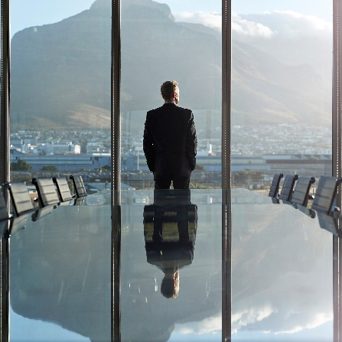



Domestic trends| Travel Behaviour (1/2)
WHAT IS HAPPENING IN SA?
Cost of living –increase in interest rates in July 2022 to 5,50%, rising inflation to a 13-year high and steeper fuel prices (R26,31 in July 2022 from R17,20 in July 2021) are affecting consumers, especially middle-income consumers
Load shedding – the unsteady has created a security risk in the country (including the cost of electricity 9.6% tariff increase from 1 April, while Eskom had requested a 20.5% increase from the National Energy Regulator of South Africa - NERSA) and has impacted consumers in terms of safety and security. Especially when travelling in an unfamiliar destination, where one must navigate (in the dark)
Consumer confidence – was at -25 in Q2 2022, the lowest it has ever been in three decades. Consumers are pessimistic about the economy and their financial situation The confidence level of middle-income households slumped from -11 to -23, while low-income confidence declined from -6 to -16 index points.
Black swan events – South Africa has experienced several unpredictable events (KZN social unrest, KZN Floods, global pandemic, etc.) that have had negative impacts on travel in general
Source: Salesforce, Statistics South Africa, FNB/BER, Eskom, Automobile Association

Slide 40




Domestic trends| Travel Behaviour (2/2)
WHAT IS HAPPENING IN SA?
Cost of taking a holiday – average demand should not be outstripping supply and yet prices for travel have drastically increased. Accommodation ( 3-5 star hotels) increased by 21% while air tickets increased by 28% and public transport increased by 14%.
Socialising - socializing is one of the key activities in domestic travel and the recent criminal attacks in social spaces (such as taverns) have increased concern for safety and security when one goes out to socialize. This has also put a spot on alcohol consumption in South Africa and the effects thereof.
Religious activities – for the first time ever, religious activities were in the top 5 activities undertaken by domestic tourists in 2021. Surpassing nightlife and beach activities. This is aligned with the rise in the acceptance of African spirituality.
Trust – consumers want brands that they can trust and deliver on their promises. Consumers are losing confidence in the government and now they are looking to brands they trust will deliver and fulfil their needs
Source: Salesforce, SA Tourism Domestic Survey, STR, Forward Keys

Slide 41
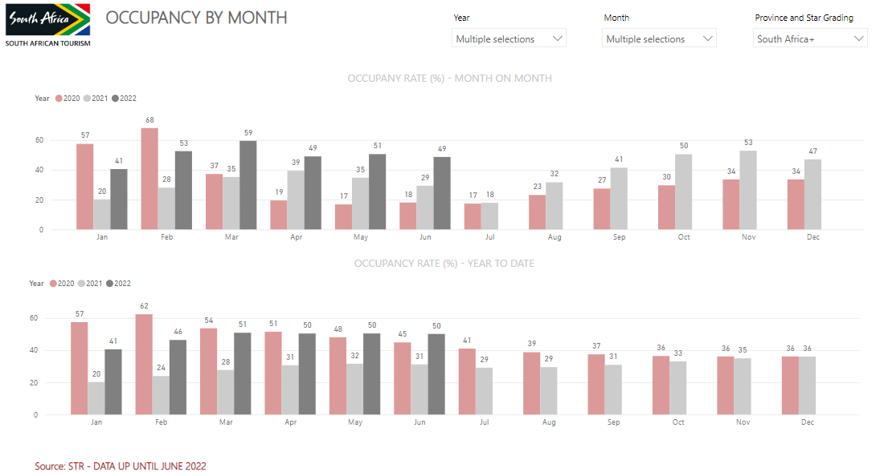
Occupancy rates in South Africa
For the last quarter (Oct – Dec) of 2021, occupancy rates for 3-5 star hotels in South Africa were the highest compared to the rest of the quarters in 2021.
October 2021 had the highest occupancy rate for the year. However, due to the discovery of the Omicron variant in November, the occupancy rates declined as tourists were cancelling their bookings to South Africa.
As the travel restrictions were eased and other countries removed the travel ban on South Africa, the occupancy rates in the first quarter (Jan – Mar) of 2022 started to increase. March 2022 had the highest occupancy rate since the beginning of the global pandemic, recording a 59% occupancy rate for South Africa.
Source:STR

Slide 42

African Travel Insights
Travel barriers in Africa are visa processing (where relevant), safety/security, and welcoming
In addition to COVID-19 travel restrictions and/or requirements and barriers, these have been long-standing issues for the continent.
For South Africa to unlock travel to South Africa from the continent, a seamless visa processing experience is needed with a quick turnaround time. The introduction of e-visas has assisted in the visa issues.
There are also on-the-ground visa application-related issues that African travellers encounter.

Slide 43

African Travel Insights
Safety/security and welcoming have been major issues, with the recent political unrest exacerbating the issue.
Racial profiling is an issue for African travellers, as they feel discriminated against when they visit South Africa.
Load shedding negatively affect the destination for tourism purposes, as potential travellers might not feel safe travelling to the country.
Lack of electricity would affect several tourism experiences, attractions, and products.
Inflation rates have increased throughout Africa and is putting a strain of the purse strings of Africans.

Slide 44
American Travel Insights
According to the UNWTO the Americas is performing minus 40% below 2019 levels. This is the second-best performing region next to Europe (-36%)
United and Delta are the only active airlines in the region.
Arrivals are expected to exceed 2019 levels in 2026
More than four in 10 (43%) American travelers now say rising gas prices will greatly impact their decision to travel in the next six months
Consumer confidence has continued to fall in the first half of 2022 this drop is driven by inflation and rising gas and food prices
According to Skift more than half of Americans travelled in July. This is despite the rising travel costs and concerns on inflation. 53.3% of Americans travelled in July 2022. The summer vacation accounted for nearly half of all July trips, 47% of July trips were for vacations while business travel remained small in share.
International the international travel rate remained high, outbound travel accounted for 7% of all trips in July.
Arrivals from Canada are expected to recover to 2019 levels in 2025. The 2022 arrival expectations are for 30 070 tourist arrivals, up 27% from 2021
Direct airlift from Canada is needed to see recovery from this market as Covid-19 makes travel more complicated for travelers and connecting flights to some destinations that require multiple tests makes travel prohibitively expensive.
Arrivals from Brazil are expected to recover to 2019 levels in 2026. The 2022 arrival expectations are for 26 530 tourist arrivals, up 84% from 2021.

Slide 45
Europe Travel Insights
Europe is leading the recovery globally and is minus 36% below 2019 levels and for most countries in Europe, South Africa is expected to recover in 2025
Airlift through Europe has doubled its seat capacity from 2021, the UK and Switzerland are up due to pandemic airline closures in 2021 with the waves of covid and the different variant discovered through the year
Consumer confidence in most European countries has fallen to the lowest levels in recent years. the reason for this fall is driven by the increase in fuel prices, increase in food prices, and higher levels of inflation overall. A major contributor to this increase has been the war between Russia and Ukraine.
In the UK specifically, UK holidaymakers are experiencing Travel disruption with transport operators facing operational difficulties, which has led to airlines having to cancel flights at short notice.
Travelers from Europe are looking to spend more time with family post-pandemic and I'm looking to spend time in outdoor spaces, getting immersed in local culture, and taking a holiday that supports sustainability.
Europeans are becoming more price conscious and are looking for value for money in long-haul destinations as well as destinations with the favorable exchange rate. In the past two years, Europeans have become heavy domestic and regional travelers due to the restrictions on long-haul travel.
Across the Europe travel advisories, they continue to warn travelers. Travellers are particularly warned about crime in South Africa and to be always vigilant when in South Africa.

Slide 46
Asia Australia and the Middle East
The Asia and Pacific region is performing at minus 90% below global levels and is the worst performing region globally. The reason for this performance are the closed borders as well as very restrictive travel rules.
In the Middle East, Qatar, Emirates and Etihad are the only carriers in the region, Saudi Arabia has had no direct flights since November 2021. Seat capacity has grown while the average fares have decreased
In Asia and Australasia: Singapore, Qantas, and Air China are the only direct airlift in the region and fares are up over both 2021 and 2019 levels. Despite the massive increase in capacity from 2021 the region remains very low in capacity recovery from 2019
Qantas is restoring international flights faster than planned to handle the stunning demand and experiencing a rebound in travel. Seats on their international flights are about 90% filled. Daily services to London and Singapore are completely fully booked across all classes. Capacity is expected to be back at 100% of the pre-covid levels by the end of the year.
Australian consumer sentiment slumped in August to a level consistent with the weak economic conditions that occurred during the Global Financial Crisis. The unemployment rate had fallen to its lowest level in 48 years.

Slide 47
Asia Australia and the Middle East
Globally as more countries open their borders to international tourism, the absence of Chinese visitors is causing more than a little economic pain. Three years into the COVID-19 pandemic, many destinations are starting to realise that it will be a while till the Chinese tourists return.
Consumers in China are suffering a crisis of confidence, which could be a huge obstacle to the country’s economic recovery, according to company owners and entrepreneurs. Rising concerns about consumer and business confidence – as strict curbs aimed at stamping out Covid-19 undercut a return to prosperity, have hampered growth in the world’s second-largest economy
Analysts expect China to grow 4% this year, according to a Reuters poll, a level most countries would envy but sluggish by its own standards.
Consumer confidence is hovering near record lows, private investment slowed in the first half, and youth unemployment is at a record 19.3%, prompting calls for more urgent government stimulus.

Slide 48
Asia Australia and the Middle East
Tourists from most countries can now enter Japan on package tours. Students, business travelers, and relatives of long-term/permanent residents can also enter. In all cases, you must apply for a visa. Independent tourists are not yet granted entry, although they can be expected to be allowed back by late 2022
Arrivals from India are expected to recover to 2019 levels in 2025. The 2022 arrival expectations are for 40 990 tourist arrivals, up 40% from 2021
India is way ahead of its global counterparts in business travel with almost 18% of Indians traveling for work within the country once a month. In terms of leisure travel, over 36% of Indians are most likely to take road trips in 2022, followed by long weekends influencing 34% of Indians to bite the travel bug. Indians indicated that their destination choice would be based on value for money and a relaxing travel experience.
In India consumer confidence is improving with the easing of mobility restrictions. There is an appetite for spending among the top 10 income percentile of the population that has not spent for more than a year and thus is onto revenge buying and traveling.

Slide 49
What are the key global trends in travel?

Slide 50
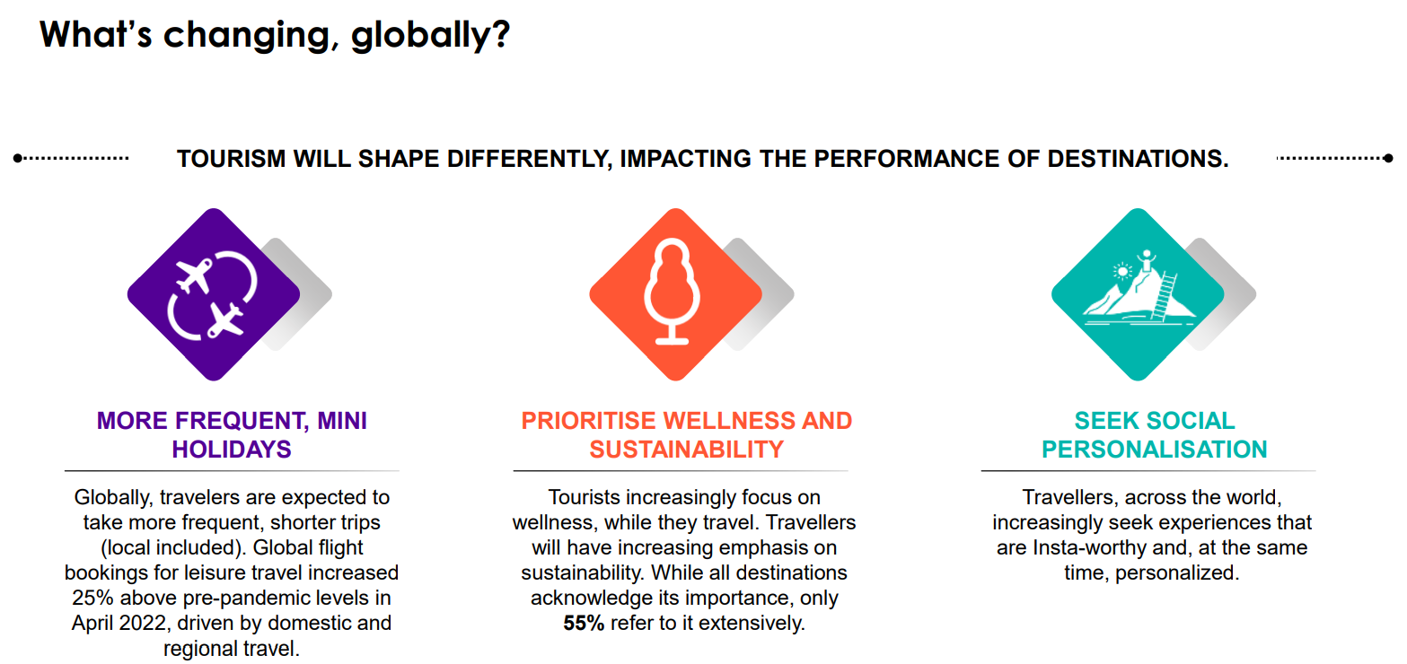

Slide 51
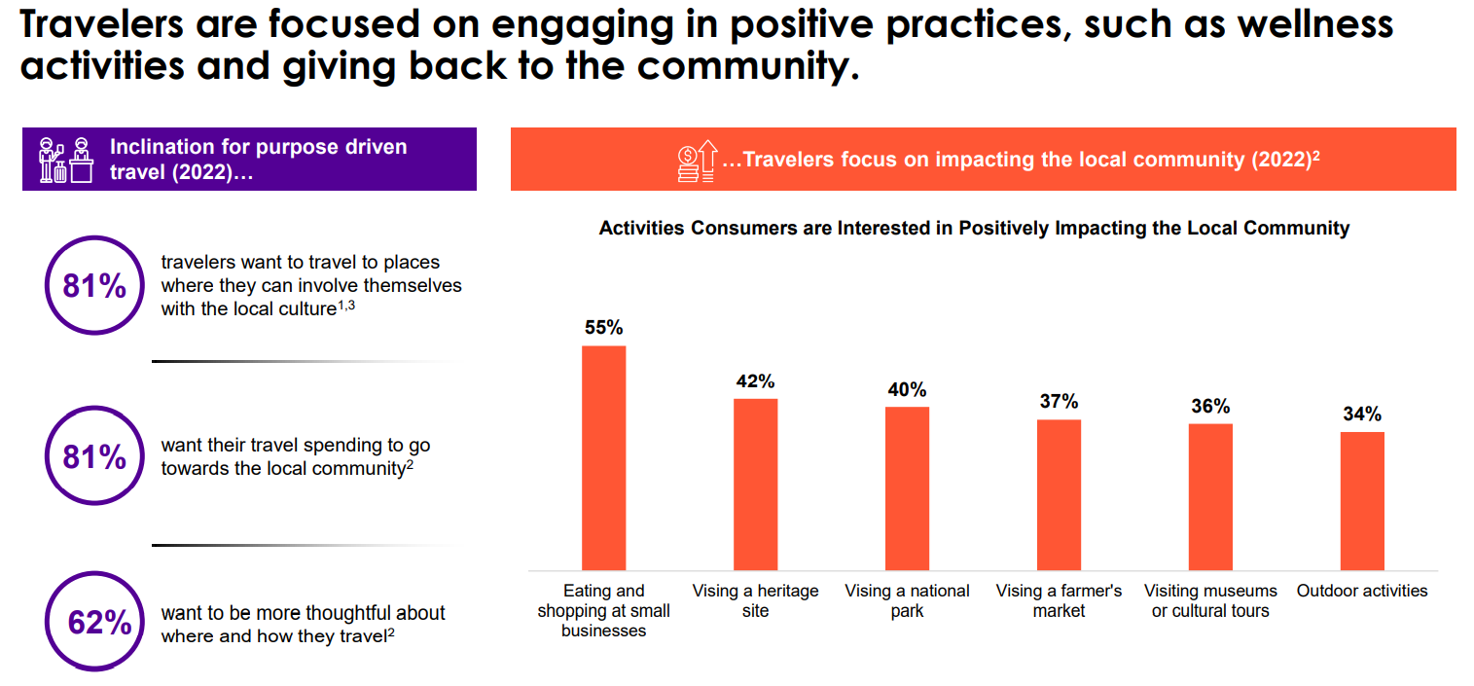

Slide 52
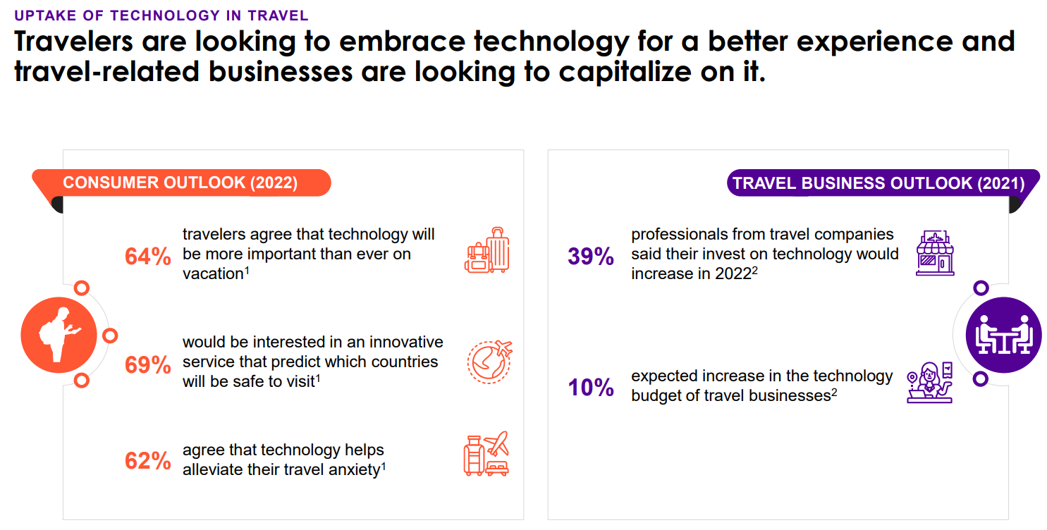

Slide 53
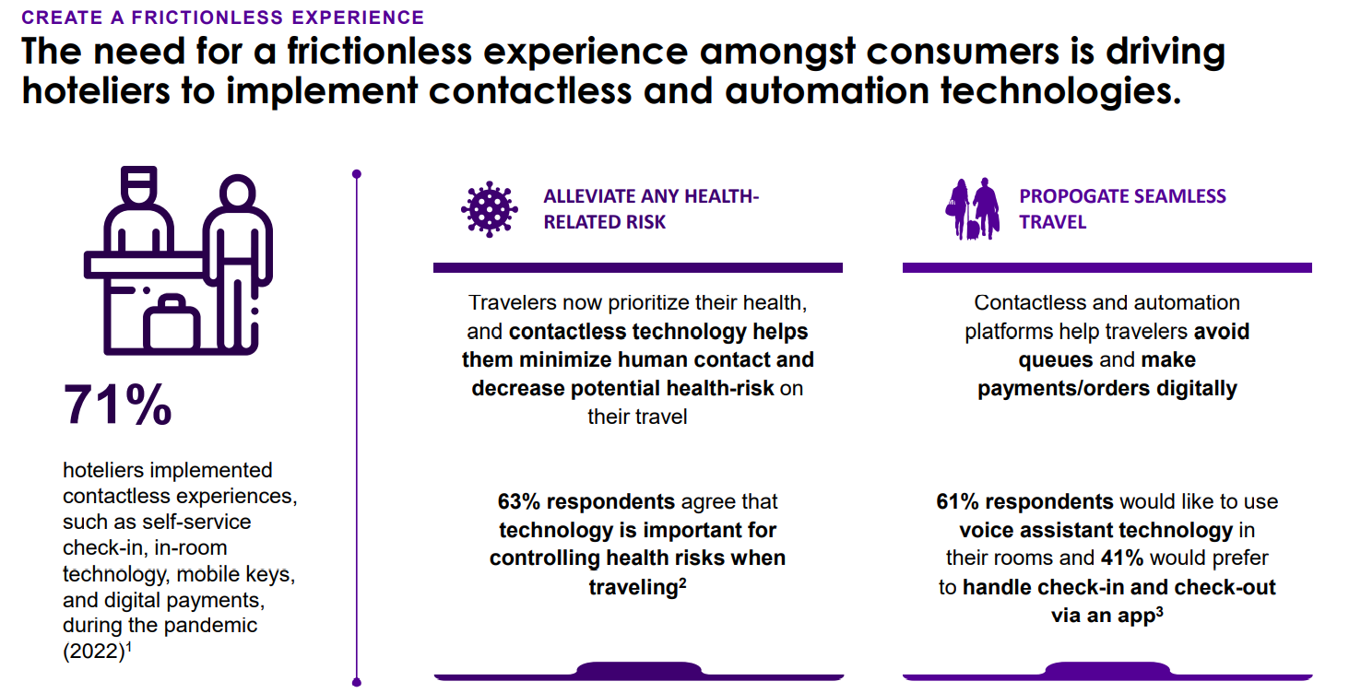

Slide 54
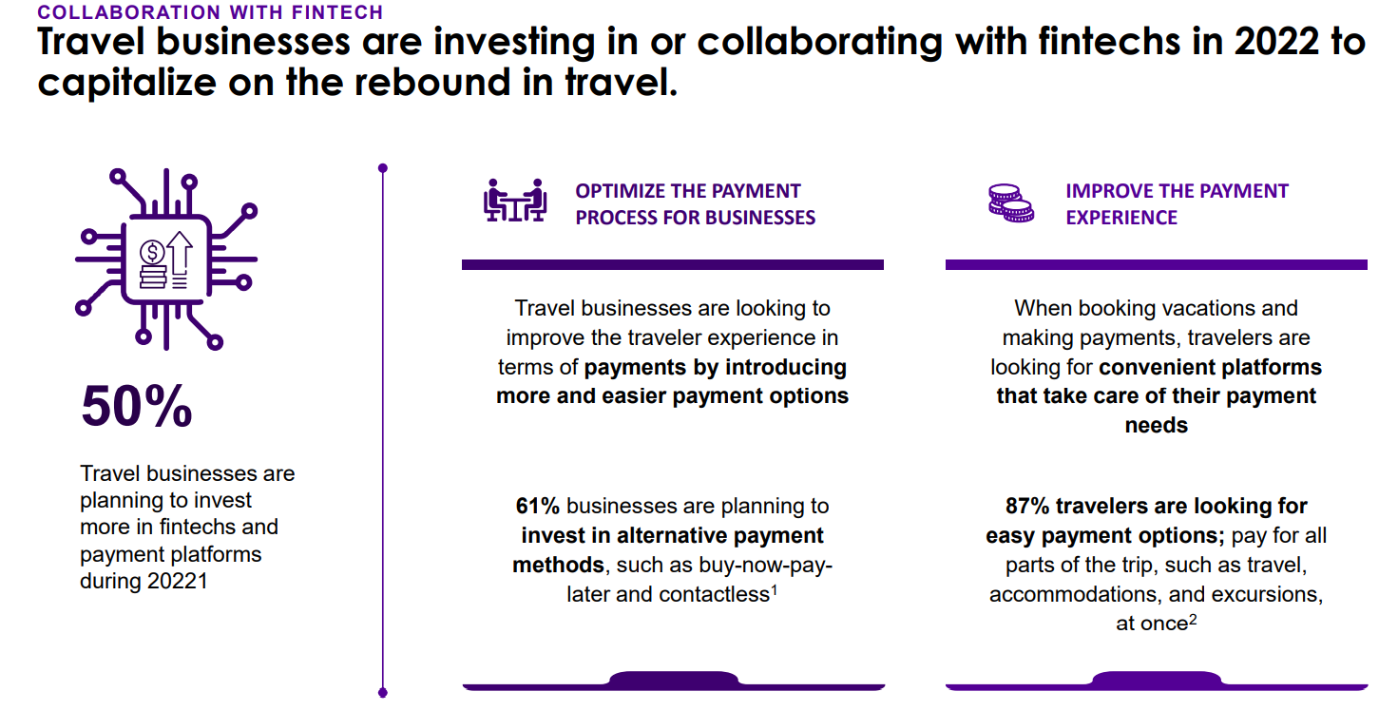
Digital Lending and Credit. FinTech giant Kabbage directly funds small business loans and is powered by transactional data to help make incredibly quick lending decisions. ...
Mobile Banking. ...
Mobile Payments. ...
Cryptocurrency & Blockchain

Slide 55
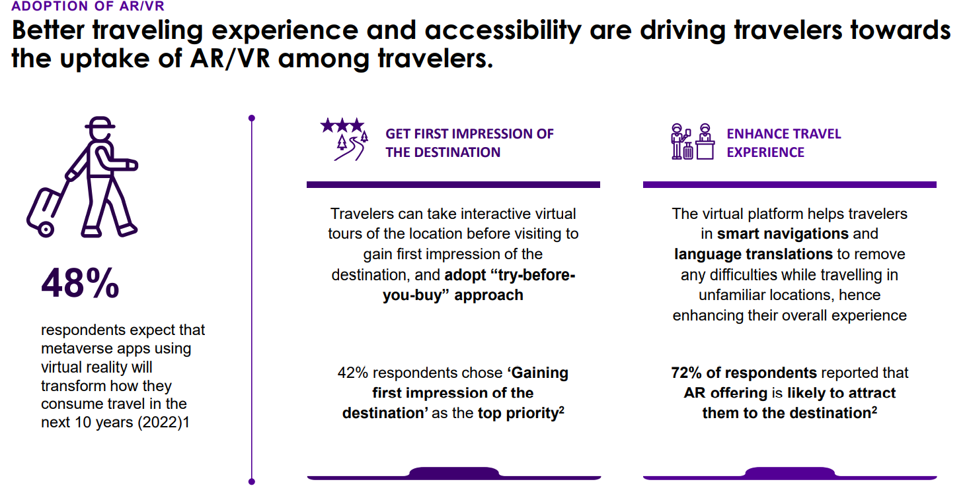

Slide 56
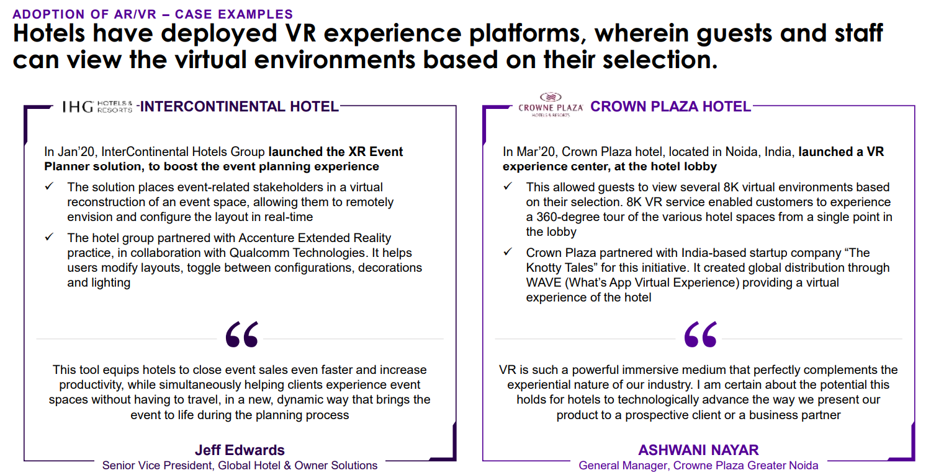

Slide 57
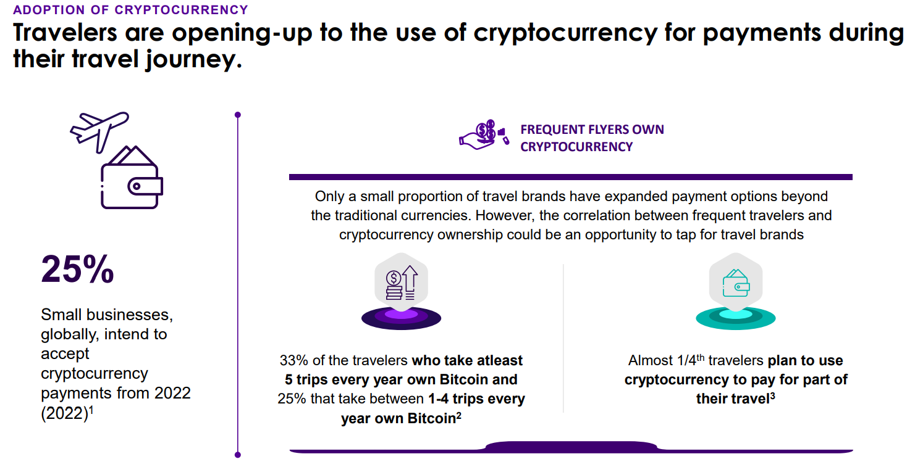

Slide 58
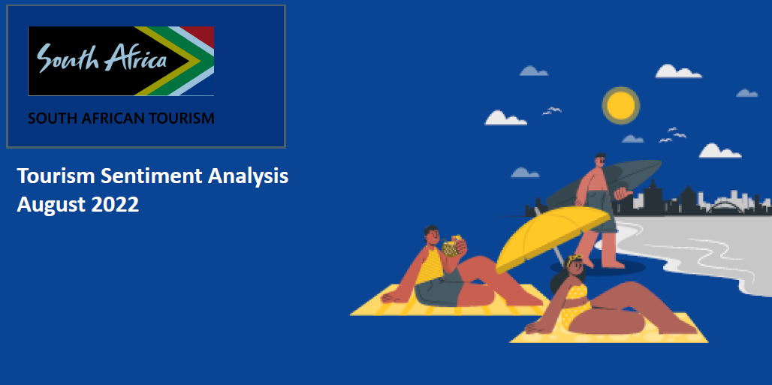
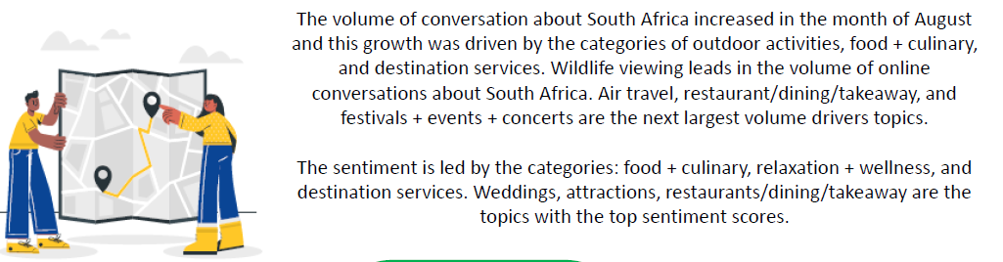
Tourism Sentiment Index (TSI) lets us measure what people really feel and what they find most worthy to share about our destination.

Slide 59
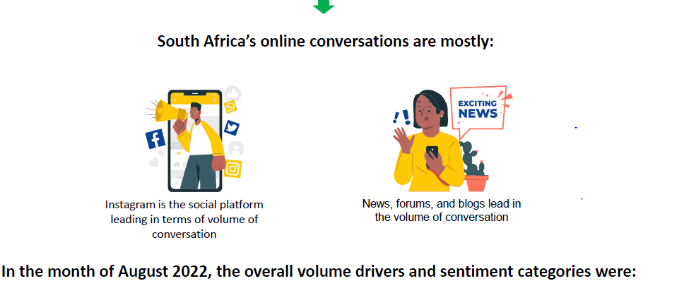
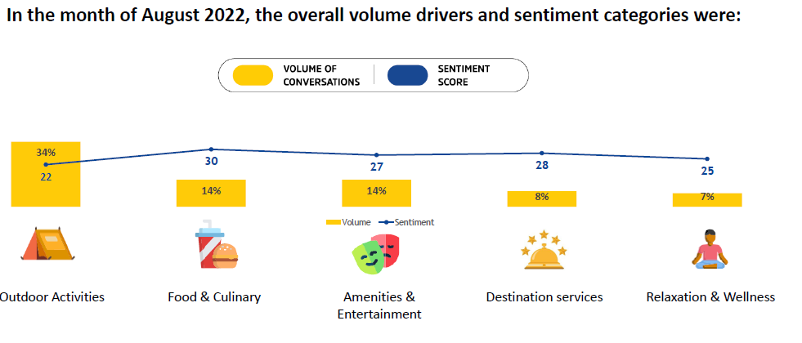

Slide 60
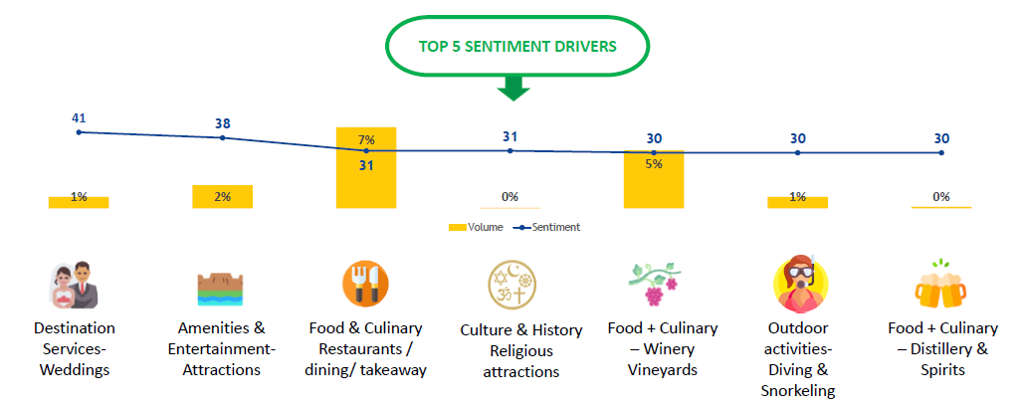
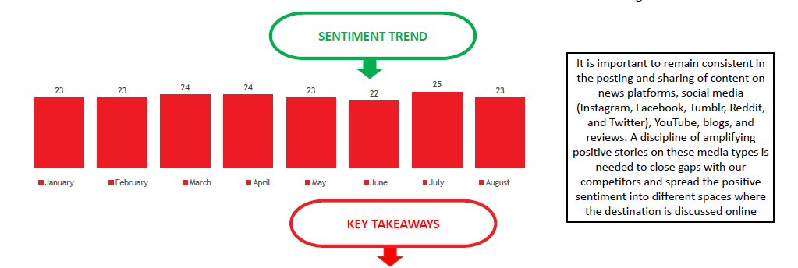

Slide 61
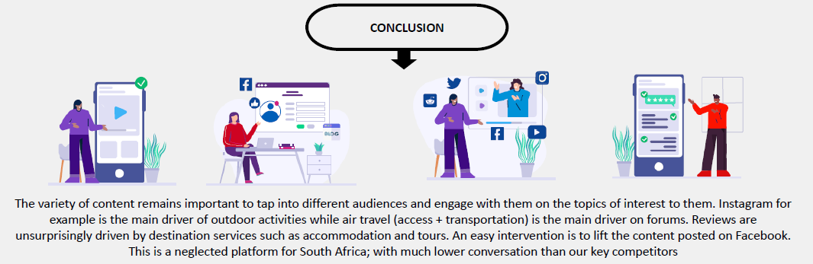

Slide 62
THANK YOU
This presentation was compiled by the Analytics & Insights BU at South African Tourism.
For more information, contact us at ai@southafrica.net
Our reports are also downloadable on www.southafrica.net

